Slide 1
Data Management: Best Practices for Groups
Dr. David Hoover, HPC @ NIH
hooverdm@hpc.nih.gov
24 April 2019

Slide 2
Outline
Purpose and goals
Hassles with shared data
Fundamentals of file access permissions
Modifying and maintaining file access permissions
Organizing and tracking data
Transferring data
Group and data lifecycle

Slide 3
Purpose of Group and Shared Data
Shared data processing using similar methods
Software development and testing (version control?)
Pooled storage for single lab or core (not archiving!)

Slide 4



Group
group1 (user1, user2, user3)
1
2
3

Slide 5

Problem 1
user2 and user3 can’t write in new directories
[user3]$ cd /data/group1/project1
[user3]$ mkdir 190320_test
[user2]$ cd /data/group1/project1/190320_test
[user2]$ mkdir subdir
mkdir: cannot create directory ‘subdir’: Permission denied
[user2]$ ls -ld .
drwxr-x--- 1 user3 group1 1024 Mar 21 12:00 .
2

Slide 6

Problem 2
Group members can (or can’t) delete each other’s files
[user2]$ touch /data/group1/project1/datafile.txt
-rw-rw---- 1 user2 group1 1024 Mar 21 12:00 datafile.txt
[user3]$ rm /data/group1/project1/*
2
3

Slide 7

Problem 3
Slurm job output not accessible by group
[user1]$ sbatch /data/group1/bin/shared_script.sh
12345678
[user2]$ ls -l /data/group1/project2/12345678_output
-rw------- 1 user2 user1 1024 Mar 21 12:00 logfile.out
-rw------- 1 user2 user1 1024 Mar 21 12:00 results.out
1
2

Slide 8
Problem 4
Files are difficult to find
Data becomes lost
Traversing data is very slow
[user1]$ time ls /data/group1/working/output
real 23m5.003s
user 0m7.603s
sys 0m3.022s
[user1]$ ls /data/group1/working/output | wc -l
1500100
1

Slide 9
Problem 5
There is not enough storage to hold all our data
[user3]$ ./run_script.sh
run_script.sh: write error: Disk quota exceeded
3

Slide 10

FUNDAMENTALS

Slide 11
UNIX Account
A user account on a UNIX system has two numeric attributes, user id (uid) and group id (gid)
A user always belongs to their own group
$ id user1
uid=1(user1) gid=1(user1) groups=1(user1)
1

Slide 12
UNIX Files
A file on a UNIX system has three attributes: read, write, execute
These attributes can be set for: owner, group, world
Attributes can be represented as a single number: mode
$ ls -l file
-rw-r----- 1 user1 user1 1024 Mar 21 12:00 file
$ stat -c %a file
640

Slide 13
UNIX mask
A user account on a UNIX system has a default mask value for the mode, as seen with the umask command:
This value acts as a bit filter when determining file mode
$ umask
027

Slide 14
UNIX File Permissions
The default permission mode of a file is 666
The resulting permission on a created file depends on the current mask of the user
The default mask value on HPC is set to 027
To calculate mode of file, subtract 027 from 666:
666 – 027 = 640

Slide 15
UNIX Directory Permissions
Directories have 777 as the default permission.
777 – 027 = 750
$ ls -ld dir
-rwxr-x--- 1 user1 user1 4096 Mar 21 12:00 dir
$ stat -c %a dir
750

Slide 16
UNIX Groups
A UNIX group is a set of user accounts with a unique group name and group identification number (group and gid)
The purpose of a UNIX group is to allow the members of the group to share files
File sharing is done on the basis of permissions for the UNIX group of the file

Slide 17
UNIX Groups
Users belong to their own primary group
$ groups user1
user1 : user1
$ groups user2
user2 : user2
$ groups user3
user3 : user3
1
2
3

Slide 18
UNIX Groups
A new group can be created to hold multiple users (only by sysadmin)
This is a secondary group
$ getent group group1
group1:x:2001:user1,user2,user3
1
2
3

Slide 19
UNIX Groups
The primary group is listed before secondary groups
A user can belong to more than one secondary group
$ groups user1
user1 : user1 group1
$ groups user2
user2 : user2 group1
$ groups user3
user3 : user3 group1

Slide 20
Sharing Files
/home directories are strictly for individuals
/scratch and /tmp are temporary
/data directories can be used, but…

Slide 21
Shared Data Directories
A shared data directory is created for the group
user1 is the group owner, who has management responsibility
The PI has ultimate authority over the data
$ ls -ld /data/group1/
drwxrws--- 2 user1 group1 4096 Mar 21 12:00 /data/group1/

Slide 22
Group Sharing
By default, members of a group still create files with their primary group
[user1]$ touch file1
-rw-r----- 1 user1 user1 1024 Mar 21 12:00 file1
[user2]$ touch file2
-rw-r----- 1 user2 user2 1024 Mar 21 12:00 file2
[user3]$ touch file3
-rw-r----- 1 user3 user3 1024 Mar 21 12:00 file3

Slide 23
Changing group
Users can change the group of their own files and directories
This can be pretty tedious
[user1]$ ls -l file1
-rw-r----- 1 user1 user1 1024 Mar 21 12:00 file1
[user1]$ chgrp group1 file1
[user1]$ ls -l file1
-rw-r----- 1 user1 group1 1024 Mar 21 12:00 file1

Slide 24
Shared Data Directories
The /data directory has setgid set:
This causes all new files and directories created to inherit the group
$ ls -ld /data/group1/
drwxrws--- 2 user1 group1 4096 Mar 21 12:00 /data/group1/
[user3]$ touch file
[user3]$ ls -l file
-rwxr----- 1 user3 group1 0 Mar 21 12:00 file

Slide 25
Shared Data Directories
The setgid bit also propagates setgid
[user3]$ ls -ld /data/group1
drwxrws--- 2 user1 group1 4096 Mar 21 12:00 /data/group1/
[user3]$ mkdir dir
[user3]$ ls -ld dir
drwxr-s--- 1 user3 group1 4096 Mar 21 12:00 dir
[user3]$ mkdir dir/sub
[user3]$ ls -ld dir/sub
drwxr-s--- 1 user3 group1 4096 Mar 21 12:00 dir/sub

Slide 26
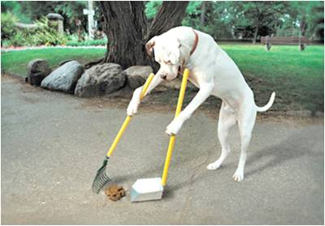
MAINTENANCE

Slide 27
Changing Permissions
Permissions can be changed with chmod:
Usually done with symbolic representation:
$ ls -l file
-rw-r----- 1 user1 user1 1024 Mar 21 12:00 file
$ chmod 660 file
$ ls -l file
-rw-rw---- 1 user1 user1 1024 Mar 21 12:00 file
$ ls -ld dir
-rwxr-x--- 1 user1 user1 4096 Mar 21 12:00 dir
$ chmod g+w dir
$ ls -ld dir
-rwxrwx--- 1 user1 user1 4096 Mar 21 12:00 dir

Slide 28
Generic shared /data
$ tree –pugF /data/group1/
/data/group1
├── [drwxr-s--- user2 group1 ] bin/
├── [drwxrws--- user1 group1 ] project1/
├── [drwxrws--- user1 group1 ] project2/
├── [drwxr-s--- user3 group1 ] reference/
├── [drwxr-s--- user1 group1 ] user1/
├── [drwxr-s--- user2 group1 ] user2/
├── [drwxr-s--- user3 group1 ] user3/
└── [drwxrws--- user1 group1 ] working/
1
2
3

Slide 29
Problem 1: umask
Custom mask
[user3]$ echo umask 007 >> ~/.bashrc
[user3]$ source ~/.bashrc
[user3]$ cd /data/group1/project1
[user3]$ mkdir 190320_test
[user3]$ ls -ld 190320_test
drwxrws--- 1 user3 group1 1024 Mar 21 12:00 190320_test
3
2
[user2]$ cd /data/group1/project1/190320_test
[user2]$ mkdir subdir
[user2]$ ls -ld subdir
drwxrws--- 1 user2 group1 1024 Mar 21 12:00 subdir

Slide 30
Problem 2: stickybit
Allows group members to create and edit files, but not delete them
Shorthand:
Sticky bit is not inherited or propagated
[user1]$ chmod +t project1
[user1]$ ls -ld project1
drwxrws--T 1 user1 group1 4096 Mar 21 12:00 project1
[user1]$ mkdir -m 3770 project1

Slide 31
Problem 3: sbatch options
Run job as group explicitly
[user1]$ sbatch --gid=group1 --partition=norm --time=10 \
--gres=lscratch:10 submit.sh
12345678
...
[user1]$ ls -l
-rw-rw-r-- 1 user1 group1 728 Mar 20 12:00 slurm-12345678.out

Slide 32
Problem 3: sbatch options
Run job with explicit umask
[user2]$ SLURM_UMASK=007 sbatch --partition=norm \
--gid=group1 --time=10 --gres=lscratch:10 submit.sh
87654321
...
[user2]$ ls -l
-rw-rw---- 1 user2 group1 728 Mar 20 12:00 slurm-87654321.out

Slide 33
Set mask to 007
Edit ~/.bashrc
[user2]$ cat ~/.bashrc
# .bashrc
# Source global definitions
if [ -f /etc/bashrc ]; then
. /etc/bashrc
fi
umask=007

Slide 34
Shared Data Directories and ACLs
All new /data directories (GPFS) allow Access Control Lists (ACLs)
ACLs allow for more fine-grained access controls

Slide 35
ACLs
An ACL can be seen with getfacl
$ getfacl /data/group1/
# file: /data/group1/
# owner: user1
# group: group1
# flags: -s-
user::rwx
group::rwx
mask::rwx
other::---

Slide 36
Setting ACL with setfacl
[user1]$ cd /data/group1/
[user1]$ ls -ld project1
drwxr-s--- 2 user1 group1 4096 Mar 22 12:00 project1
[user1]$ setfacl -m u:user2:rwx project1
[user1]$ ls -ld project1
drwxrws---+ 2 user1 group1 4096 Mar 22 12:00 project1
[user1]$ getfacl project1
# file: project1/
# owner: user1
# group: group1
# flags: -s-
user::rwx
user:user2:rwx
group::r-x
mask::rwx
other::---

Slide 37
ACLs override group permissions
Standard UNIX group permissions become the ACL mask
The mask is the maximum access type for all members of the ACLs

Slide 38
Effect of chmod
[user1]$ ls -ld project1
drwxrws---+ 2 user1 group1 4096 Mar 22 12:00 project1
[user1]$ getfacl project1
user:user2:rwx
group::r-x
mask::rwx
[user1]$ chmod g-w project1
drwxr-s---+ 2 user1 group1 4096 Mar 22 12:00 project1
[user1]$ getfacl project1
user:user2:rwx #effective:r-x
group::r-x
mask::r-x

Slide 39
Multiple ACs per file
[user1]$ setfacl -m u:user3:r-x project1
[user1]$ getfacl project1
# file: project1
# owner: user1
# group: group1
# flags: -s-
user::rwx
user:user2:rwx #effective:r-x
user:user3:r-x
group::r-x
mask::r-x
other::---

Slide 40
Copying ACLs to new files
Use --set-file=-
[user1]$ setfacl project1 | --set-file=- project2
[user1]$ getfacl project2
# file: project1
# owner: user1
# group: group1
# flags: -s-
user::rwx
user:user2:rwx
user:user3:r-x
group::rwx
mask::rwx
other::---

Slide 41
Propagate ACLs By Default
[user1]$ setfacl -m d:u:user2:rwx project2
[user1]$ getfacl project2
# file: project1
# owner: user1
# group: group1
# flags: -s-
user::rwx
user:user2:rwx
user:user3:r-x
group::rwx
mask::rwx
other::---
default:user::rwx
default:user:user2:rwx
default:group::rwx
default:mask::rwx
default:other::---

Slide 42
Propagate ACLs By Default
[user1]$ mkdir project2/190320_test1
[user1]$ getfacl project2/190320_test1
# file: project2/190320_test1
# owner: user1
# group: group1
# flags: -s-
user::rwx
user:user2:rwx
user:user3:r-x
group::rwx
mask::rwx
other::---
default:user::rwx
default:user:user2:rwx
default:group::rwx
default:mask::rwx
default:other::---

Slide 43
Default ACLs supersede umask
Setting umask 077 should disallow all group access, but default ACLs win…
[user1]$ umask 077
[user1]$ mkdir project2/190320_test2
[user1]$ ls -l project2
drwxrws---+ 2 user1 group1 4096 Mar 22 15:02 190320_test1
drwxrws---+ 2 user1 group1 4096 Mar 22 15:02 190320_test2
[user1]$ touch user1/project1/190320_test2/file
[user1]$ ls -l user1/project1/190320_test2/file
-rw-rw---- 1 user1 group1 4096 Mar 22 15:02 file

Slide 44
Shared /data directory
$ tree –pugF /data/group1/
/data/group1
├── [drwxr-s---+ user2 group1 ] bin/
├── [drwxrws---+ user1 group1 ] project1/
├── [drwxrws---+ user1 group1 ] project2/
├── [drwxr-s--- user3 group1 ] reference/
├── [drwxr-s--- user1 group1 ] user1/
├── [drwxr-s--- user2 group1 ] user2/
├── [drwxr-s--- user3 group1 ] user3/
└── [drwxrws--T user1 group1 ] working/
1
2
3

Slide 45
Ongoing Maintenance
Permissions can get messed up very easily
Moving, rather than copying files
Applications explicitly set permissions
Slurm runs as primary group
[user1]$ ls -l project2
-rwxrwxrwx 1 user2 user2 4321 Mar 22 12:00 file.out
drwx------ 2 user1 user1 4096 Mar 22 15:00 results1
-rwx------ 1 user3 group1 12345 Mar 22 12:00 results1.txt

Slide 46
find … -exec chmod
Bulldoze over permissions
More precision with conditional execute
[user1]$ find . -exec chmod g+rwx {} +
[user1]$ find . -exec chmod g+rwX {} +

Slide 47
find … -exec setfacl
find can’t detect ACLs
[user1]$ setfacl -R –m g:group1:rwX,d:g:group1:rwX,o:--- .

Slide 48
Carefully find
Running find on >1M files can take >10 minutes
Automating is possible, but should be done on a cluster node
Should be targeted not blind blanket

Slide 49
find … -exec chmod
find and chmod
find and chgrp
[user1]$ find . -perm /u+r -user user1 ! -perm /g+r \
-exec chmod g+r {} +
[user1]$ find . -perm /u+w -user user1 ! -perm /g+w \
-exec chmod g+w {} +
[user1]$ find . -perm /u+x -user user1 ! -perm /g+x \
-exec chmod g+x {} +
[user1]$ find . -user user1 ! -group group1 \
-exec chgrp group1 {} +

Slide 50
Targeted setfacl
Redundant chmod updates ctime
[user1]$ stat file -c %z
2019-03-22 12:00:00.000000000 -0400
[user1]$ chmod g+rwx file
[user1]$ stat file –c %z
2019-03-25 09:00:00.000000000 -0400
[user1]$ chmod g+rwx file
[user1]$ stat file –c %z
2019-03-25 09:00:07.747292784 -0400

Slide 51
Targeted setfacl
Redundant setfacl does not change ctime
[user1]$ stat file -c %z
2019-03-22 12:00:00.000000000 -0400
[user1]$ setfacl –m g:group1:rwX
[user1]$ stat file –c %z
2019-03-25 09:00:00.000000000 -0400
[user1]$ setfacl –m g:group1:rwX
[user1]$ stat file –c %z
2019-03-25 09:00:00.000000000 -0400

Slide 52
Targeted setfacl
Combine find and setfacl
ctime changes when a file is modified or permissions are changed
[user1]$ find . –ctime -1 –exec \
setfacl –m g:group1:rwX,d:g:group1:rwX,o:--- {} +

Slide 53
Index projects
Use updatedb and locate to index files
Searchable with locate
[user1]$ cd /data/group1
[user1]$ updatedb \
--database-root project1 \
--output project1.db --require-visibility no
[user1]$ locate --database=project1.db this_file
/gpfs/gsfs11/users/group1/project1/dir/dir/this_file.txt

Slide 54
updatedb and locate
>1M files can take ~2-3 minutes to index
Searching is much, much faster than find
Can pass results to grep
Can only search by name, not by properties (size, mtime, permissions)
[user1]$ locate --database=project1.db / | grep this | \
grep that | grep other

Slide 55

ORGANIZATION AND MONITORING

Slide 56
Setting Boundaries
Many problems can be solved through structural design
Design subdirectories for different purposes

Slide 57
Organize Files
No more than 1000 files per directory
File/directory names should be systematic and logical
Store date, keywords in name
$ ls /data/group1/project2/C5/
190320_r1/ 190320_r2/ 190320_r3/ 190320_r4/
190321_r1/ 190321_r2/ 190321_r3/ 190321_r4/
README.txt r1.bam r1.bam.bai r2.bam
r2.bam.bai r3.bam r3.bam.bai r4.bam
r4.bam.bai template.sh

Slide 58
Metadata
Document data as it is added
$ cat /data/group1/project2/C5/190320_r1/README.txt
================================
2019-03-20, user2
Run 1, trial C5, project1
See submit_r1.sh for methodology and commands run
Used template.sh to generate submit_r1.sh

Slide 59
Segregate by expected lifetime
How long do you expect the file to be needed?
/lscratch if only for lifetime of job
/data if for a few months
/home if for longer

Slide 60
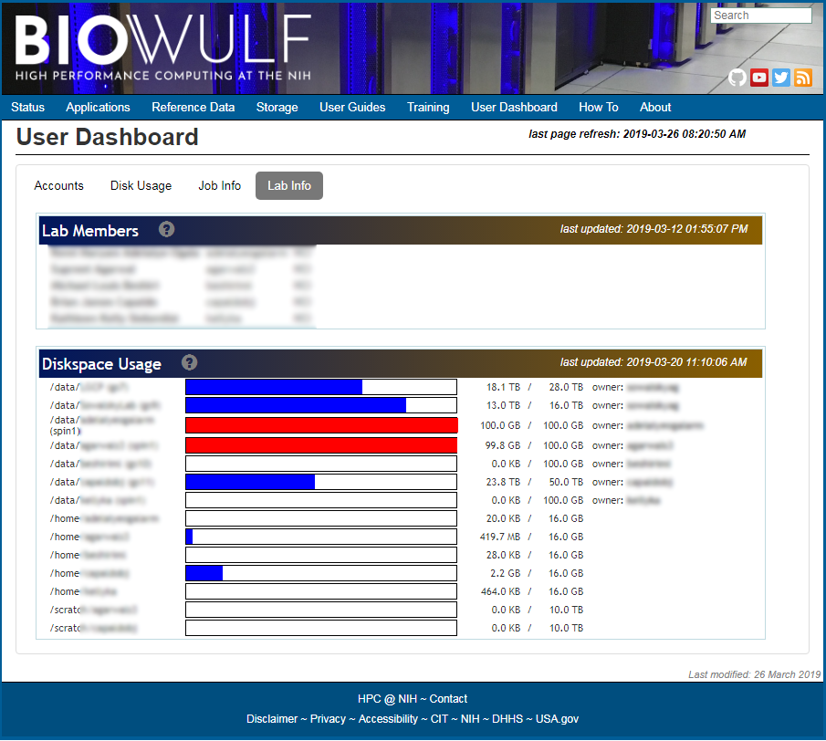
Dashboard

Slide 61
checkquota
$ checkquota
Mount Used Quota Percent Files Limit
/data: 417.8 GB 500.0 GB 83.56% 441553 31129581
/gs10(group1): 100.6 GB 5.0 TB 0.21% 40667 31457280
/home: 12.1 GB 16.0 GB 75.62% 108094 n/a
ObjectStore Vaults
user1: 5.7 MB 465.7 GB 0.00% n/a n/a

Slide 62
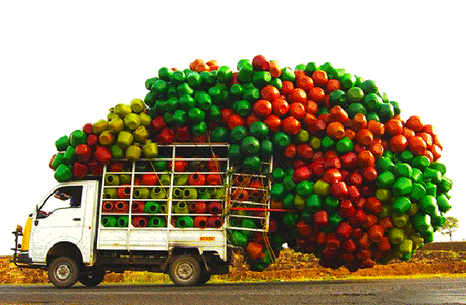
FILE TRANSFER AND ARCHIVING

Slide 63
Compression
Use gzip to compress files
$ ls -l
-rw-r--r-- 1 user1 group1 641955988 Sep 22 2018 bogus_R1_001.fastq
-rw-r--r-- 1 user1 group1 643754231 Sep 22 2018 bogus_R2_001.fastq
$ gzip *.fastq
$ ls -l
-rw-r----- 1 user1 group1 134381309 Sep 22 2018 bogus_R1_001.fastq.gz
-rw-r----- 1 user1 group1 134873947 Sep 22 2018 bogus_R1_001.fastq.gz

Slide 64
Compression Algorithms
247 MB typical file on /spin1
Additional compression settings (1..9), default is 6
Compression depends on randomness of data
Command | C time | Size | Ratio | D time
gzip | 15.8 s | 66 M | 26.7% | 2.2 s
bzip2 | 61.6 s | 47 M | 19.0% | 10.8 s
xz | 199.0 s | 32 M | 12.9% | 3.7 s

Slide 65
Compress Limitations
Not all files can be compressed
Ext | File Type | gzip | xz -9
.bam | gzip compressed data, extra field | 100% | 100%
.tiff | TIFF image data, little-endian | 99.2% | 99.2%
.jpg | JPEG image data, EXIF standard | 97.2% | 97.2%
.png | PNG image data, … | 97.7% | 95.9%
.hdf | Hierarchical Data Format (v5) | 92.7% | 90.9%
.mrc | CCP4 Electron Density Map | 92.8% | 82.1%
.pdf | PDF document | 100% | 56.6%
.tif | TIFF image data, big-endian | 7.3% | 4.7%
.bed | ASCII text, with very long lines | 9.2% | 4.3%

Slide 66
Compress Projects
As projects wrap up, compress files into tarball
Also searchable:
[user1]$ cd /data/group1
[user1]$ tar czf project1.tgz project1
[user1]$ tar tzf project1.tgz this_file
project1/dir/dir/this_file.txt

Slide 67
Archiving Data
HPC is NOT suitable for archival storage
Regular backups are NOT done
Users are encouraged to seek out alternative means of archiving their data

Slide 68
Push to Object Storage
Short-term archiving
https://hpc.nih.gov/storage/object.html
Vaults can hold files for 7 years
[user1]$ obj_put -V -p "group1/" project1.tgz

Slide 69
Transfer: Helixdrive
Allows local mount of exported file systems
/home, /data, /scratch
Available for Windows, Macs and Linux
Speed: slow
Reliability: moderate
Ease: high

Slide 70
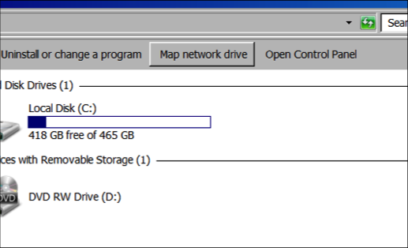
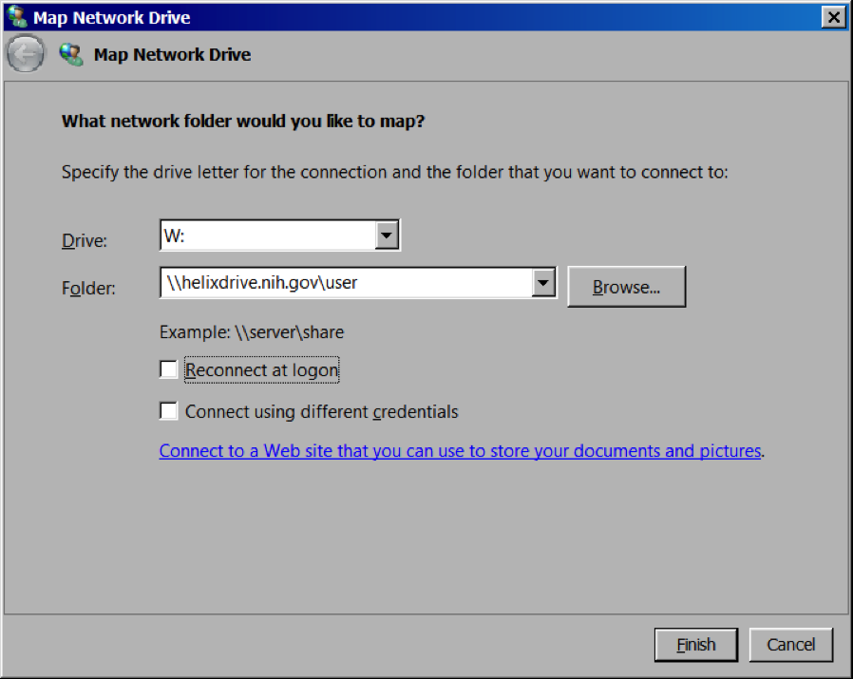

Transfer: Helixdrive

Slide 71
Transfer: Helixdrive
$ mount -t cifs –o rw,vers=2.0,nosetuids,sec=ntlmsspi,user=user1,domain=NIH.gov //helixdrive.nih.gov/group1 /mnt/biowulf_group1

Slide 72
Transfer: rsync
Can be run to/from helix.nih.gov
Available for Mac, Linux
There are rsync wrapper clients for Windows
Speed: moderate
Reliability: high
Ease: high/low, depends on OS

Slide 73
SSH Keys
Must have at least 2048 bit encryption
Must have a secret passphrase
Length beats complexity
SSH keys do NOT override AD password expiration and shell locking
https://hpc.nih.gov/docs/sshkeys.html

Slide 74
rsync Using SSH Keys
$ rsync -avz -e "ssh -i foo_rsa“ \
user1@helix.nih.gov:/data/group1/project1 \
/path/on/desktop/

Slide 75
Key Storage Agents
ssh-agent (Linux, Mac)
pageant (Windows, with PuTTY)
Stores private key and passphrase, allows single authentication, multiple connects

Slide 76
Transfer: Globus
Service provided by University of Chicago
Requires local client and port availability
Available for Windows, Mac, Linux
Speed: fast
Reliability: high
Ease: moderate

Slide 77
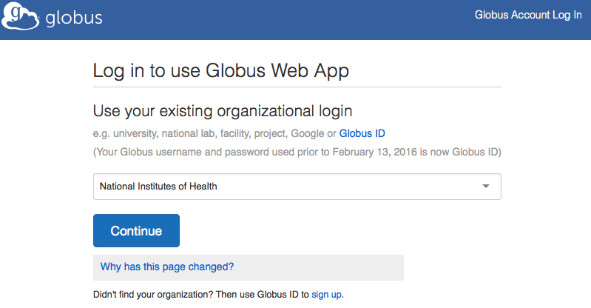
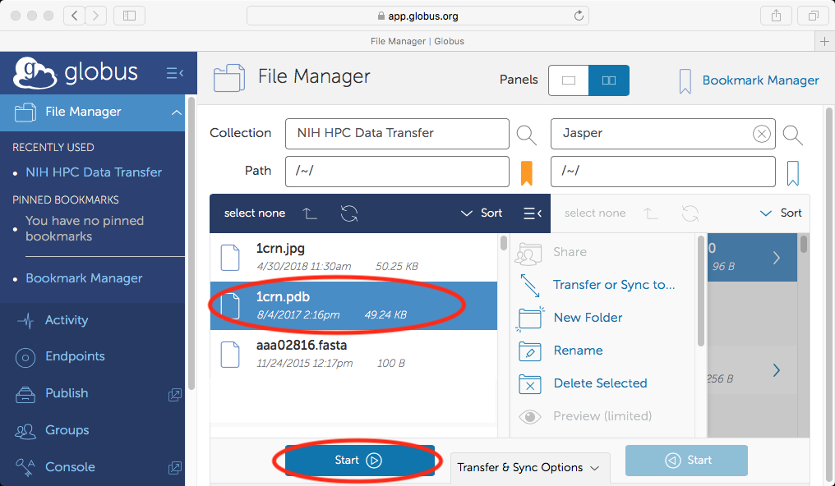
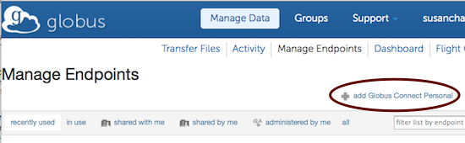
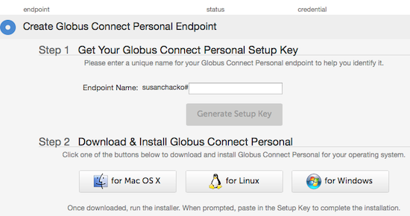
Transfer: Globus

Slide 78
Transfer: Globus CLI
Takes some doing, but very worth it
Can be incorporated into batch scripts
[user1]$ globus transfer --recursive --no-verify-checksum \
d8eb36b6-6d04-11e5-ba46-22000b92c6ec:/path/to/local/dir/ \
e2620047-6d04-11e5-ba46-22000b92c6ec:/data/group1/project1/
Message: The transfer has been accepted and a task has been created and queued for execution
Task ID: 6924b21e-f54b-11e6-ba69-22000b9a448b

Slide 79
Transfer: Amazon & Google Cloud
Cloud-based storage obtained outside of HPC
Various clients available
Must be run from helix.nih.gov
Speed: ?
Reliability: ?
Ease: low

Slide 80
Transfer: Google Cloud
https://cloud.google.com/storage/docs/gsutil
[user1@helix ~]$ module load google-cloud-sdk
[user1@helix ~]$ gcloud init
[user1@helix ~]$ gsutil -m cp gs://my_bucket/* /data/group1/project3/.

Slide 81
Transfer: Google Drive
gdrive can automate transfers
[user1@helix ~]$ module load gdrive
[+] Loading gdrive 2.1.0 on helix.nih.gov
[user1@helix ~]$ gdrive download 1YQI2m_403yq-TLxJ1QHtkzKE7_c_9Gal
Authentication needed
Go to the following url in your browser:
https://accounts.google.com/o/oauth2/
auth?access_type=offline&client_id=...
Enter verification code: ...
Downloading cloudfile.zip -> cloudfile.zip
Downloaded 1YQI2m_403yq-TLxJ1QHtkzKE7_c_9Gal at 86.0 MB/s, total 23.6 GB

Slide 82
Transfer: Amazon Web Services
https://docs.aws.amazon.com/cli/latest/reference/
[user1@helix ~]$ module load aws
[user1@helix ~]$ aws s3 cp /data/group1/project2 \
s3://mybucket/myfolder –recursive
[user1@helix ~]$ cd /data/group1/project3
[user1@helix project3]$ aws s3 sync s3://mybucket/project3 project3

Slide 83
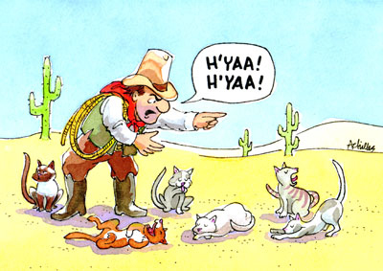
GROUP AND DATA MANAGEMENT

Slide 84

Group Communication
Who has access to what?
Is the data being maintained?

Slide 85

Group Owner
The group owner has the responsibility of managing members and permissions
Can authorize changes

Slide 86

Group Lifecycle Plan
What to do when a user leaves?
Long-term archive?

Slide 87
Data Management Plan
Create a plan or projection of what data is needed and what will be generated
Have a rough idea of scale (100GB? 100TB?)
How long will data be needed?
Who should have access?
Who has management responsibility?

Slide 88
HPC Data Lifecyle Policies
Data is ultimately owned by PI
When an account is deleted, the data is kept for six months, then deleted
The PI is alerted with options
  Change permissions (in shared /data directory)
  Merge into another directory
  Transfer the contents (size-dependent)
  Delete the data

Slide 89
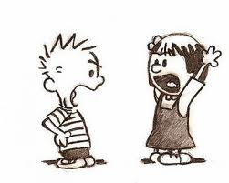
Questions? Comments?
staff@hpc.nih.gov

